Slide 1


Slide 2



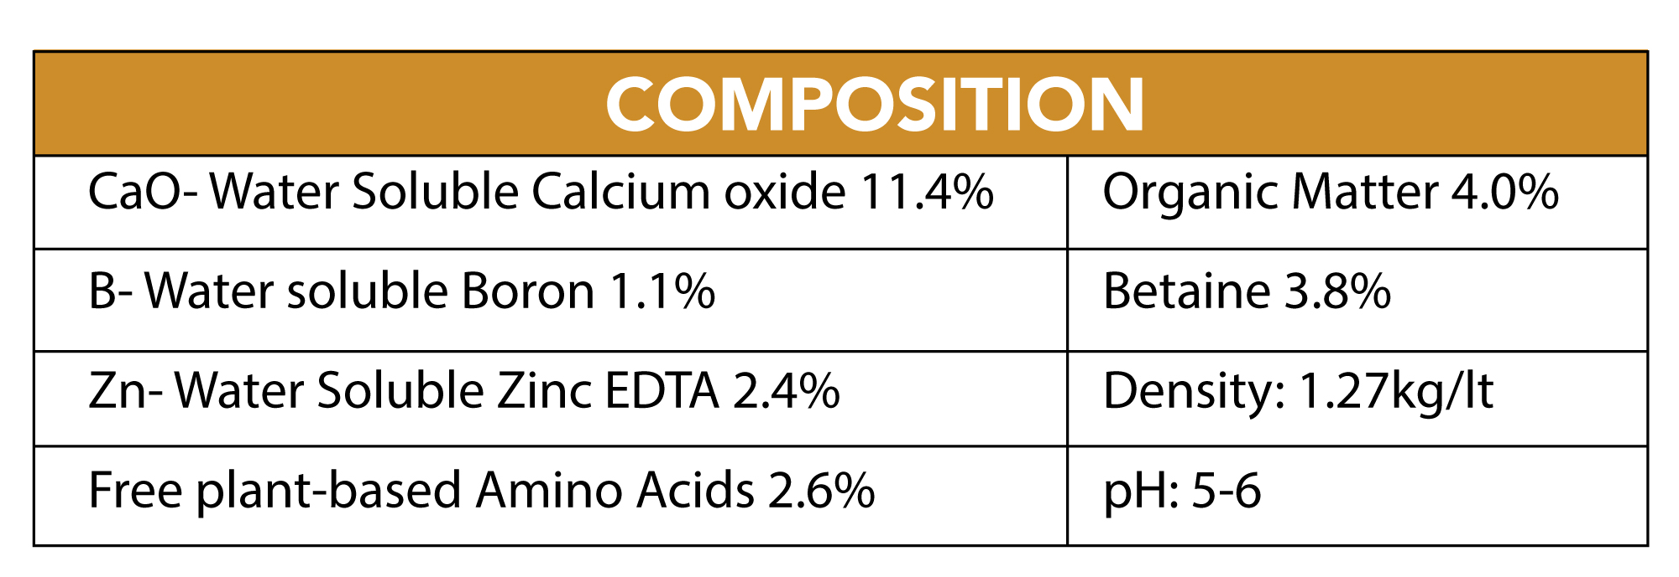
COMPOSITION

Slide 3
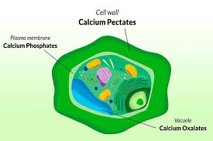
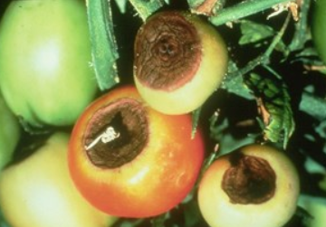
Role of Calcium
Calcium, in the form of calcium pectinate, is responsible for the cohesion of plant cell walls. Calcium slows down the senescence of tissues, gives fruits a better consistency and gives them a good resistance to parasitic attacks
When calcium is lacking, new tissues, such as root tips, young leaves and shoot ends, are often deformed due to poor cell wall formation. Calcium is also used in the activation of certain enzymes and to send signals coordinating certain cellular activities.
Calcium is not mobile in the plant. The plant therefore relies on the perspiration process in which the roots absorb water from the soil (which contains the desired calcium). It then transports this water to new shoots where calcium is used and excess water vapour escapes through the stomata of the leaves. Anything that slows down sweating, such as high humidity or cold temperatures, can cause calcium deficiency, even if calcium levels are normal in the substrate.
Parts of the plant that sweat little (i.e., young leaves and fruit) will be affected first. Apical drying of tomatoes is a classic case of calcium deficiency
Calcium deficiency on tomato

Slide 4
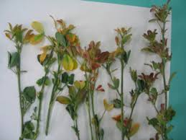
Role of Boron
It is absorbed as H3BO3
It is required utilization of Ca2+ ,and stability of the calcium pectate
Necessary for membrane functioning and cell division,
Essential for pollen germination.
Essential for cell elongation.
Boron plays an essential role in plant metabolism
By promoting the development of cell walls, bud formation,
The regulation of sugar metabolism.
An adequate supply of boron is crucial for plant growth and reproduction.

Slide 5
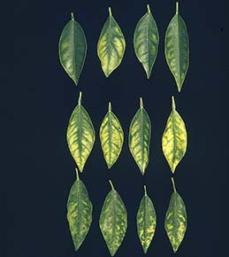
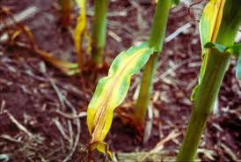
Role of Zinc
Zinc activates different enzymes or is a constituent and thus influences various metabolic processes in the plant.
Essential component of RNA polymerase, which catalyzes the synthesis of RNA. Thus the formation of proteins is also influenced.
Zinc catalyzes as a component of the enzyme, the formation of fructose 6-phosphate, which is an important metabolite for glycolysis and photosynthesis.
Necessary for ribosome stability
Influences the indole-3- acetic acid (Auxin) content, important for plant growth management

Slide 6
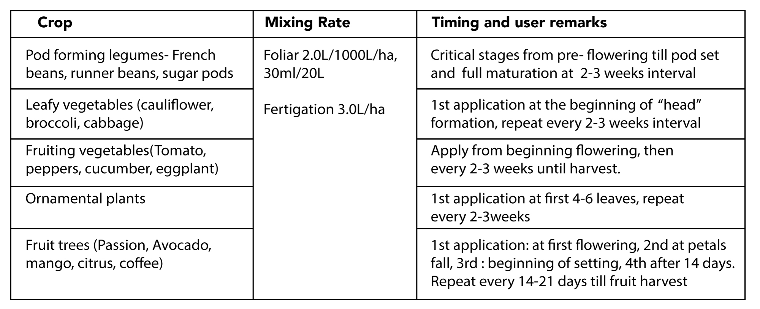
Application

